Slide 1
MacConkey Agar Plate
Name = Desai Himani
Patel Juli
Panchal amita
Field = MLT
College= Shree Manavata Seva Trust ,MLT

Slide 2
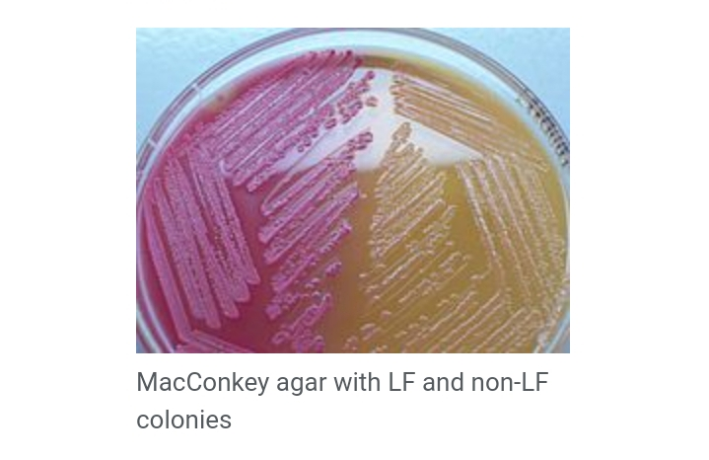
MacConkey Agar Plate

Slide 3
Definition of agar
Agar is a gelatinous substance ,thick and clear substance that comes from seaweed and used in biological culture media and as a thickener in foods.

Slide 4
Definition of macConkey agar
MacConkey agar is an indicator , a selective and differential culture medium for bacteria designed to selectively isolate Gram-negative and enteric ( normally found in the intestinal tract ) bacilli and differentiate them based on lactose fermentation.

Slide 5
The crystal violet and bile salts inhibit the growth of gram positive organisms which allows for the selection and isolation of gram negative bacteria. Enteric bacteria that have the ability to ferment lactose can be detected using the carbohydrate lactose , and the pH indicator neutral red.

Slide 6
History
The medium was developed by Alfred Theodore MacConkey while working as a bacteriologist for the Royal Commission on Sewage Disposal.

Slide 7
Principle
MacConkey agar is used for the isolation of gram-negative enteric bacteria and the differentiation of lactose fermenting from lactose non-fermenting gram-negative bacteria. Pancreatic digest of gelatin and peptones(meat and casein) provide the essential nutrient, vitamin and nitrogenous factors required for growth of microorganism . Lactose monohydrate is the fermentable source of carbohydrate.

Slide 8
The selective action of this medium is attributed to crystal violet and bile salt, which are inhibitory to most species of gram-positive bacteria. Sodium chloride maintains the osmatic balance in the medium. Neutral red is a pH indicator that turns red at a pH below 6.8 and is colorless at any pH greater than 6.8. Agar is the solidifying agent.

Slide 9
Contents
It contain bile salt (to inhibit most Gram-positive bacteria),
Crystal violet dye (which also inhibits certain Gram-positive bacteria),
Neutral red dye (which turns pink if the microbes are fermenting lactose).

Slide 10
Composition
Peptone - 17 g
Proteose peptone -3 g
Lactose - 10 g
Bile salt - 1.5 g
Sodium chloride - 5 g
Neutral red - 0.03 g
crystal violet - 0.001 g
Agar – 13.5 g
Distilled water – add to make a 1 litre

Slide 11
Preparation of MacConkey Agar
Suspend 49.53 grams of dehydrated medium in 1000 ml purified/distilled water.
Heat to boiling to dissolve the medium completely .
Sterilize by autoclaving at 15 lbs pressure (121 c)for 15 minutes.
Cool to 45-50 C.
Mix well before pouring into sterile petri plates.

Slide 12
Uses
Using neutral red pH indicator, the agar distinguishes those gram –negative bacteria that can ferment the sugar lactose ( Lac+) from those that cannot (Lac-)
This medium is also known as an “indicator medium” and a “low selective medium”. Presence of bile salt inhibits swarming by proteus species.

Slide 13
Lac positive
By utilizing the lactose available in the medium , Lac+ bacteria such as Escherichia coli , Enterobacter , klebsiella will produce acid , which lowers the pH of the agar below 6.8 and results in the appearance of pink colonies. The bile salts precipitate in the immediate neighbourhood of the colony, causing the medium surrounding the colony to become hazy.

Slide 15
Lac negative
Examples of non – lactose fermenting bacteria are salmonella , Proteus species ,Pseudomonas aeruginosa and Shigella .

Slide 17
Mucoid colonies
Some organisms , especially Klebsiella and Enterobacter , produce mucoid colonies which appear very moist and sticky . This phenomenon happens because the organism is producing a capsule , which is predominantly made from the lactose sugar in the agar.

Slide 19
ORGANISM COLOUR REMARKS
Escherichia coli red/pink non-mucoid
Aerobacter pink mucoid
aergenes
Enterococcus red minute,round
species
Staphyloccus pale pink opaque
species
Pseudomonas green- brown fluorescent
aeruginosa growth

Slide 20
Thank You

