Slide 1
NUTRIENT AGAR
Prepared by:
GOJARIYA HANI M.
CHAUHAN AKSHAY B.
PATEL ARCHANA A.

Slide 2
content
INTRODUCTION
Principle of Nutrient Agar
Composition of Nutrient Agar
Preparation of Nutrient Agar
Which Bacteria grows on nutrient agar ?
How to Make the Perfect Agar Plate Every Time
Disposal
Quality Control

Slide 3
INTRODUCTION
Nutrient agar is a general purpose medium supporting growth of a wide range of non-fastidious organisms. It typically contains (mass/volume)
0.5% Peptone - this provides organic nitrogen
0.3% beef extract/yeast extract - the water-soluble content of these contribute vitamins, carbohydrates, nitrogen, and salts
1.5% agar - this gives the mixture solidity
0.5% Sodium Chloride - this gives the mixture proportions similar to those found in the cytoplasm of most organisms
distilled water - water serves as a transport medium for the agar's various substances
pH adjusted to neutral (6.8) at 25 °C (77 °F).

Slide 4
Principle of Nutrient Agar
Nutrient Agar consists of peptone, beef extract and agar. This relatively simple formulation provides the nutrients necessary for the replication of a large number of microorganisms which are not excessively fastidious.
The beef extract contains water soluble substances including carbohydrates, vitamins, organic nitrogen compounds and salts.
Peptones are the principle sources of organic nitrogen, particularly amino acids and long-chained peptides.
Sodium chloride maintains the osmotic equilibrium of the medium. Agar is the solidifying agent.

Slide 5
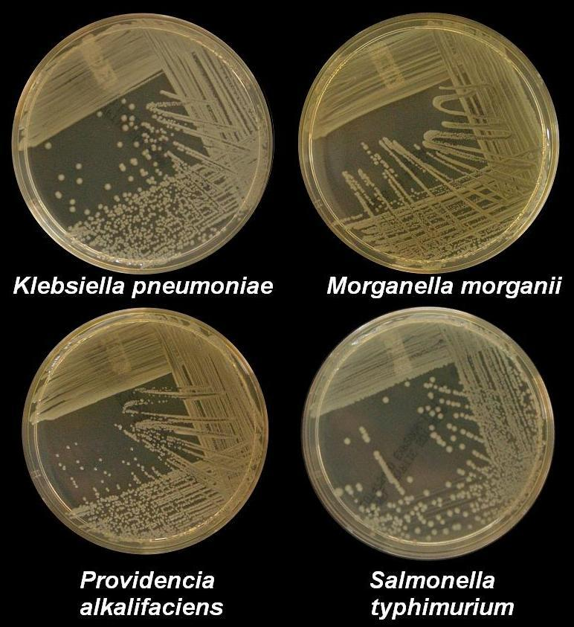

Slide 6
Composition of Nutrient Agar
Composition per liter :
Agar……………………………………….15.0 gm
Peptone……………………………..…..5.0 gm
Beef extract ………….……………….3.0 gm
Sodium chloride …………………….5.0 gm
Dist. Water……………………………..1000 ml
pH 7.4 ± 0.2 at 25°C

Slide 7
Preparation of Nutrient Agar
Add 28 gm of components to distilled water and bring volume to 1.0 L.
Mix thoroughly.
Gently heat and bring to boiling.
Distribute into tubes.
Autoclave for 15 min at 15 psi pressure 121°C.
Allow tubes to cool in a slanted position.

Slide 8
Which Bacteria grows on nutrient agar ?
Nutrient agar provides these resources for many types of microbes, from fungi like yeast and mold to common bacteria such as Streptococcus and Staphylococcus.
The microbes that can be grown on complex media such as nutrient agar can be described as nonfastidious organisms.

Slide 9
How to Make the Perfect Agar Plate Every Time
Make up the medium according to the recipe, then add the desired amount of agar (normally about 1% w/v) and stir.
Autoclave for 25 minutes.
Cool the medium-agar mix to 55°C.
Add any antibiotics or supplements.
Pour the plates.
Allow the plates to set.
Dry the plates in the laminar flow hood with the lid slightly off for 30 minutes (or in a 37°C incubator for 2-3 hours, or RT for 2-3 days).
Use the plates immediately or seal them.

Slide 10
Disposal
User must ensure safe disposal by autoclaving and/or incineration of used or unusable preparations of this product. Follow established laboratory procedures in disposing of infectious materials and material that comes into contact with clinical sample must be decontaminated and disposed of in accordance with current laboratory techniques.

Slide 11
Quality Control
Appearance :-
Cream to yellow homogeneous free flowing powder.
Gelling :-
Firm, comparable with 1.5% Agar gel.
Colour and Clarity of Prepared medium :-
Yellow coloured clear to slightly opalescent gel forms in Petri plates.
Reaction :-
Reaction of 2.3% w/v aqueous solution at 25°C.
pH :-
6.60-7.00

Slide 12
THANK
YOU

