Slide 1
SUB:MICROSCOPE
Rohit.k.janala
Yashvardhan.a.shrimali
Vikram.k.vyas

Slide 2
The history of the microscope spans centuries.
Roman philosophers mentioned “burning glasses" in their writings but the first primitive microscope was not made until the late 1300’s. Two lenses were placed at opposite ends of a tube.
This simple magnifying tube gave birth to the modern microscope

Slide 3
purpose of a microscope
First, the purpose of a microscope is to magnify a small object or to magnify the fine details of a larger object in order to examine minute specimens that cannot be seen by the naked eye.

Slide 4
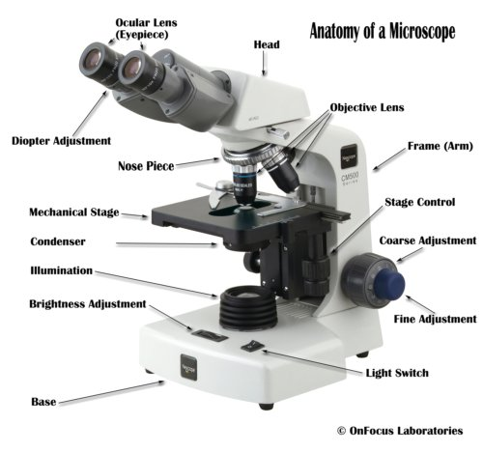

Slide 5
Eyepiece: The lens the viewer looks through to see the specimen. The eyepiece usually contains a 10X or 15X power lens.
Diopter Adjustment: Useful as a means to change focus on one eyepiece so as to correct for any difference in vision between your two eyes

Slide 6
Body tube (Head): The body tube connects the eyepiece to the objective lenses.
Arm: The arm connects the body tube to the base of the microscope.
Coarse adjustment:Brings the specimen into general focus.

Slide 7
Fine adjustment: Fine tunes the focus and increases the detail of the specimen.
Nosepiece: A rotating turret that houses the objective lenses. The viewer spins the nosepiece to select different objective lenses.

Slide 8
Objective lenses: One of the most important parts of a compound microscope, as they are the lenses closest to the specimen.
A standard microscope has three, four, or five objective lenses that range in power from 4X to 100X. When focusing the microscope, be careful that the objective lens doesn’t touch the slide, as it could break the slide and destroy the specimen.

Slide 9
Specimen or slide : The specimen is the object being examined. Most specimens are mounted on slides, flat rectangles of thin glass.
The specimen is placed on the glass and a cover slip is placed over the specimen. This allows the slide to be easily inserted or removed from the microscope. It also allows the specimen to be labeled, transported, and stored without damage

Slide 10
Stage: The flat platform where the slide is placed.
Stage clips: Metal clips that hold the slide in place.
Stage height adjustment (Stage Control): These knobs move the stage left and right or up and down.
.

Slide 11
Aperture: The hole in the middle of the stage that allows light from the illuminator to reach the specimen.
On/off switch: This switch on the base of the microscope turns the illuminator off and on.

Slide 12
Illumination: The light source for a microscope. Older microscopes used mirrors to reflect light from an external source up through the bottom of the stage; however, most microscopes now use a low-voltage bulb.
Iris diaphragm: Adjusts the amount of light that reaches the specimen.

Slide 13
Condenser: Gathers and focuses light from the illuminator onto the specimen being viewed.
Base: The base supports the microscope and it’s where illuminator is located.

Slide 14
How Does a Microscope Work?
All of the parts of a microscope work together - The light from the illuminator passes through the aperture, through the slide, and through the objective lens, where the image of the specimen is magnified.
The then magnified image continues up through the body tube of the microscope to the eyepiece, which further magnifies the image the viewer then sees.

Slide 15
The parts of a microscope work together in hospitals and in forensic labs, for scientists and students, bacteriologists and biologists so that they may view bacteria, plant and animal cells and tissues, and various microorganisms the world over.
Compound microscopes have furthered medical research, helped to solve crimes, and they have repeatedly proven invaluable in unlocking the secrets of the microscopic world.

Slide 16
Types of microscope

Slide 17
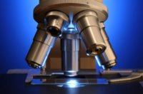
The Compound Light Microscope

Slide 18
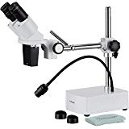
The Stereo Microscope

Slide 19
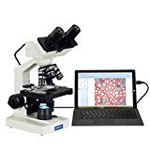
The Digital Microscope

Slide 20
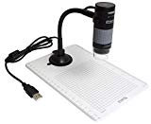
The USB Computer Microscope

Slide 21
The Pocket Microscope

Slide 22
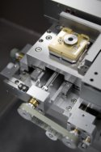
The Electron Microscope

Slide 23
The Scanning Probe Microscope (SPM)
The Acoustic Microscope

Slide 24
THANK YOU..!

